Slide 1
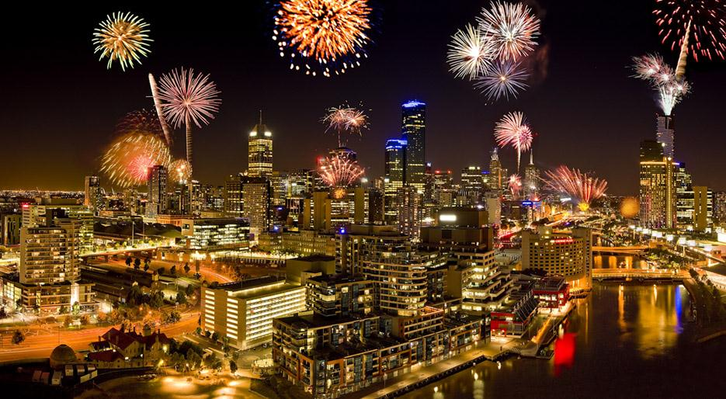
Holidays of Australia

Slide 2
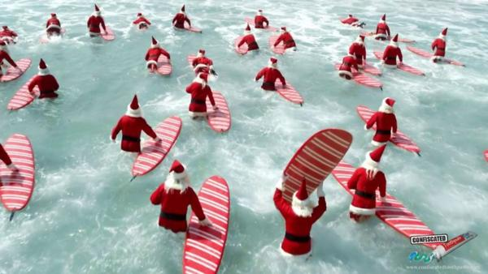
New Year
Australians celebrate the new year in the summer. All the celebration take place outdoors. This dance party, and a variety of shows, and Fireworks. In Sydney, at midnight in the famous Sydney Harbour Harbour breaks out one of the world's largest fireworks show in which every year gathers more than 1 million people.

Slide 3
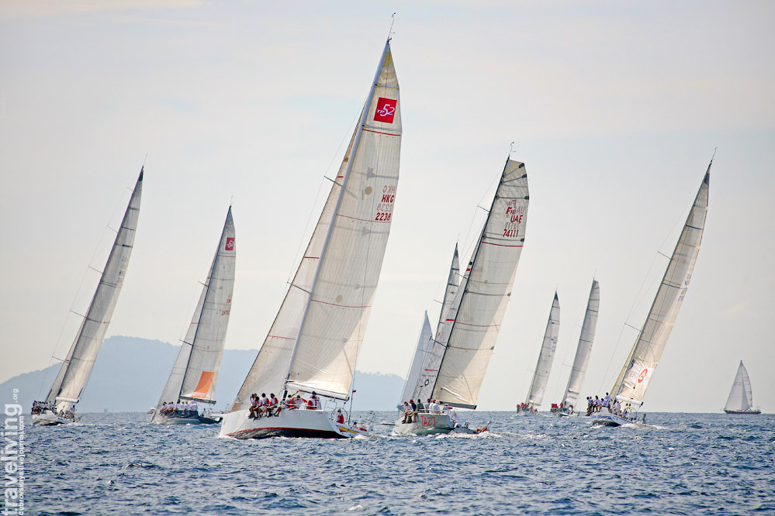
Australia Day
Australia day is January 26. This date marks the arrival of the first fleet in Sydney Harbour in 1788 ad. On this day, the Australians having fun with all my heart. On the streets of all major cities, concerts, festivals, sports events, charity barbecues and Fireworks. Many wear the national dress.

Slide 4
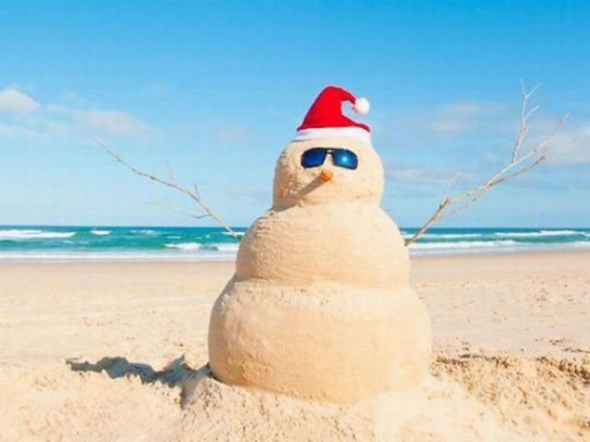
Christmas
Christmas in Australia is December, 25. Before Christmas, people dress up in caps and reindeer horns. Santa walks the streets to accept orders from kids gifts and take photos. By City pass platform with fantastic characters and brass bands. The procession ends with a reindeer sled with horse, in which sits the Santa Claus. In Adelaide, Santa Claus has his Magic cave, where and is the procession. Santa lives in this cave before Christmas and him look anyone.

Slide 5
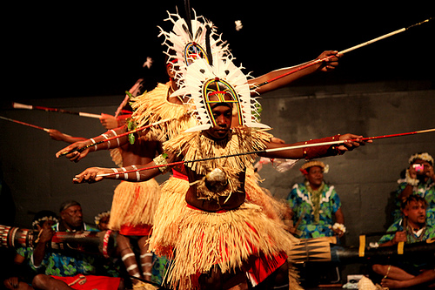
Mabo Day
Within 10 years, Aboriginal people have fought persistently for Justice, which was rebuilt after June 3, 1992 year. This date became the new national holiday Australia-Mabo Day.

Slide 6
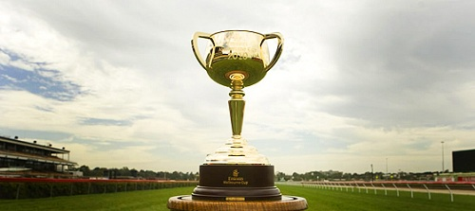
Melbourne Cup Day
The first Melbourne Cup was held in November, 1861. Melbourne Cup Prize Fund now amounts to several million dollars. And the stakes in this day does pretty much every Australian. Melbourne Cup day is the most celebrated Tuesday in Australia.

Slide 7
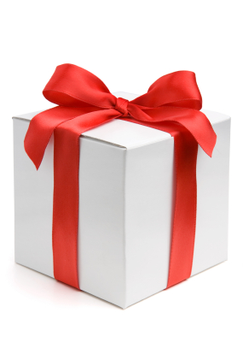
Boxing Day
Boxing Day is a holiday that is celebrated in Australia the day after Christmas. These days it has become the hallmark of giant closeouts in large and small stores. It was a day of gifts you can buy a favorite thing for half the price.

Slide 8
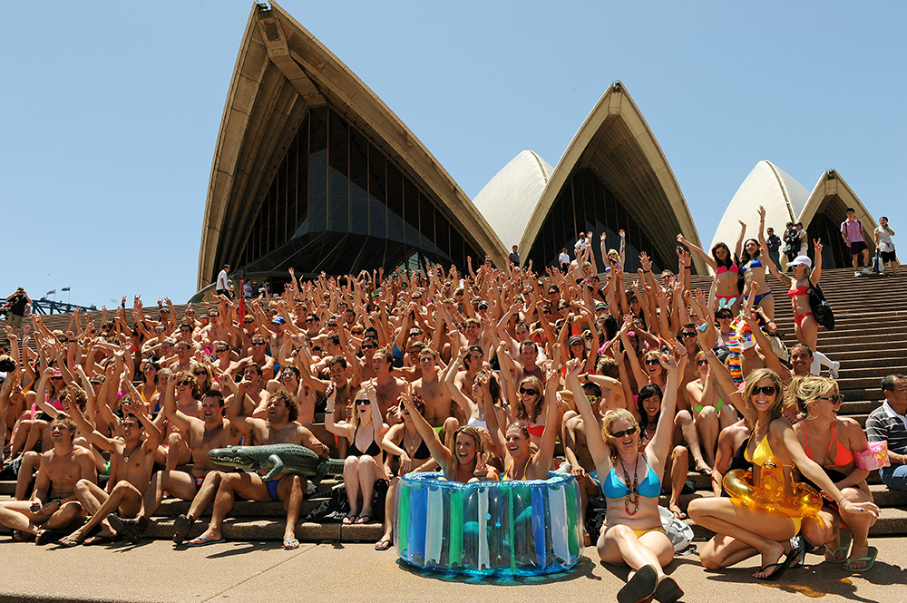
The end

