Slide 1
The Weather

Slide 2
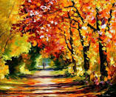
It´s …
autumn
summer
winter
spring

Slide 3
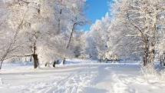
It´s …
summer
winter
autumn
spring

Slide 4
It´s …
autumn
spring
summer
winter

Slide 5
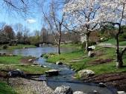
It´s …
autumn
summer
spring
winter

Slide 6
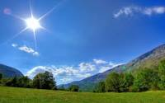
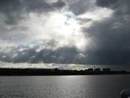
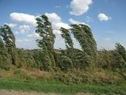
It is sunny.

Slide 7
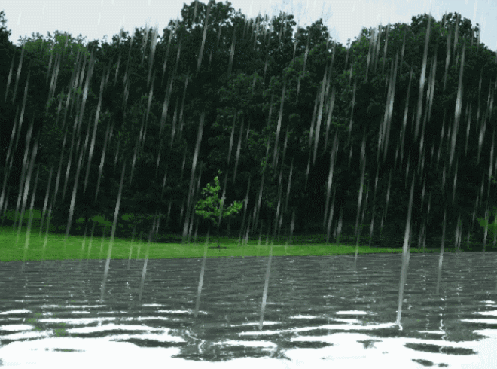
It is raining.

Slide 8
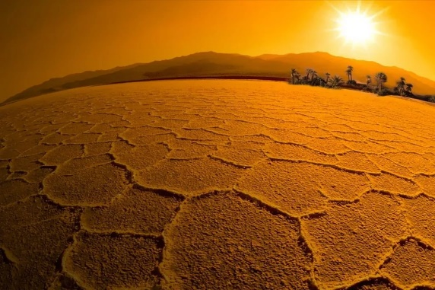
It´s hot.

Slide 9
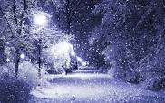
It´snowing.
It´s raining.
It´s sunny.
It´hot.

Slide 10
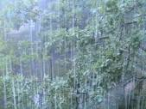
It´s sunny.
It´s hot.
It´s snowing.
It´s raining.

Slide 11
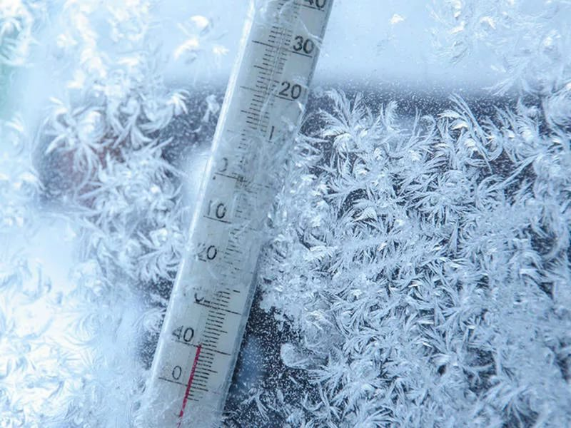
It´s sunny.
It´s hot.
It´s raining.
It´s cold.

Slide 12
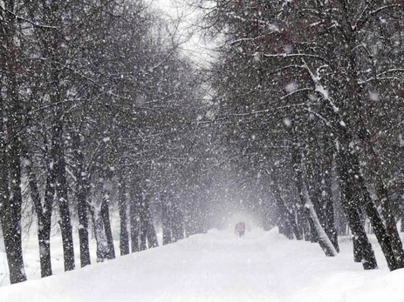
It´s hot.
It´s raining.
It´s snowing.
It´s sunny.

Slide 13
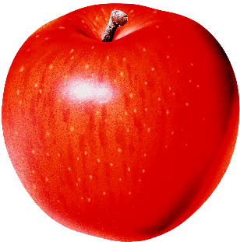
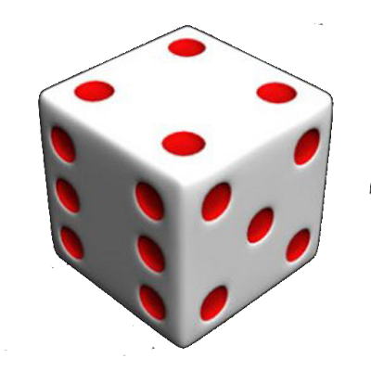
eating
I´m
apple
an
They´re
game.
a
playing

Slide 14
reading
book.
a
He´s
He´s
reading
a
book.
CD.
a
listening
She´s
to
She´s
listening
to
a
CD.
playing
football
We´re
now.
We´re
playing
football
now.

Slide 15
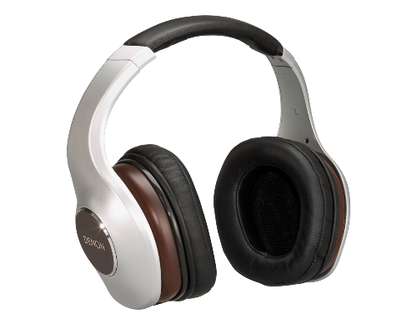
drawing
She´s
picture.
a
They´re
music.
to
listening

Slide 16
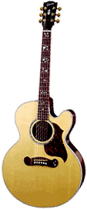
bird
singing.
is
The
The
bird
is
singing.
today.
snowing
It´s
It´s
snowing
today.
playing
the
He´s
guitar.
He´s
playing
the
guitar.

Slide 17
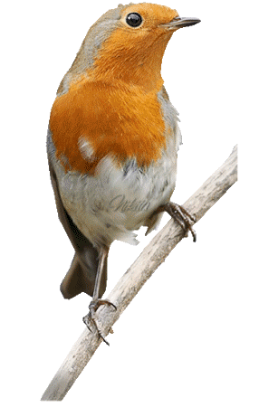
Выбери правильный вариант
The bird is ________
Tom and I _____ going to the sea.
She ___ looking at our garden.
Look! It __________ .
We __________ to Spain.
singing.
singing.
sing.
are
am
are
is
is
are
is snowing
is snow
is snowing
are flying
are flying
is flying

