Slide 1
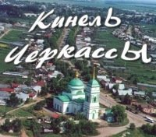
That’s My Village
Presentation was prepared by:
Altunin Iliya

Slide 2
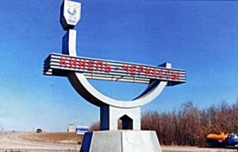
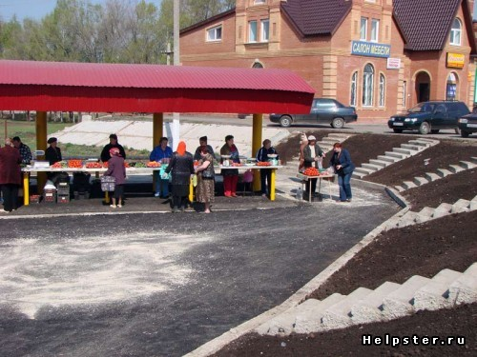
First impressions of
Kinel-Cherkassу
At the entrance to Kinel-Cherkassy, primarily striking a market in which mainly sell tomatoes, as well as the emblem of the village. Bird depicted on the emblem symbolizes freedom, because Kinel-Cherkassy settlement was free, unencumbered serfdom.

Slide 3
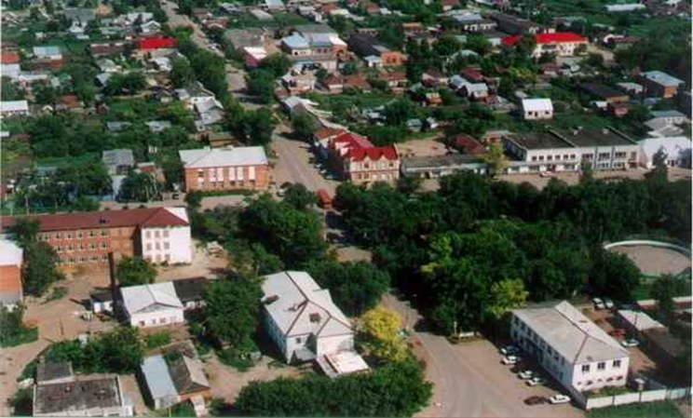
Geographical position
Kinel-Cherkassy - the village, the administrative center of Kinel-Cherkassy region of Samara region of Russia.
The largest village in the Volga region, the 29th in Russia in general.
Kinel-Cherkassy village located 110 km east of Samara on the river Bolshoy Kinel.

Slide 4
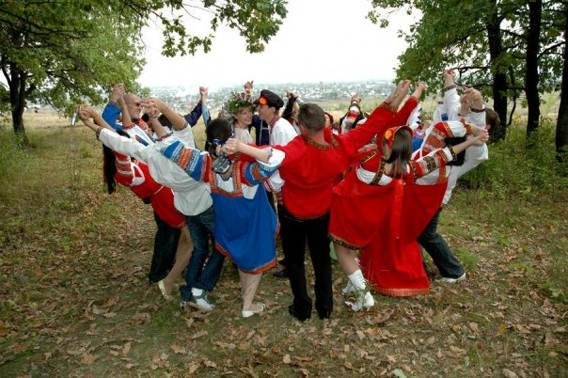
Population
Of the total population under working age 7988 people, including 4068 - and 3920 men - women; working-age population - 29,306 people, including men - 15 211, women - 14 095; working age 10,644 people, 2,909 - and 7,735 men - women.
The average life expectancy in the region of 63.82 years for men - 57.27 years for women - 71.38.

Slide 5
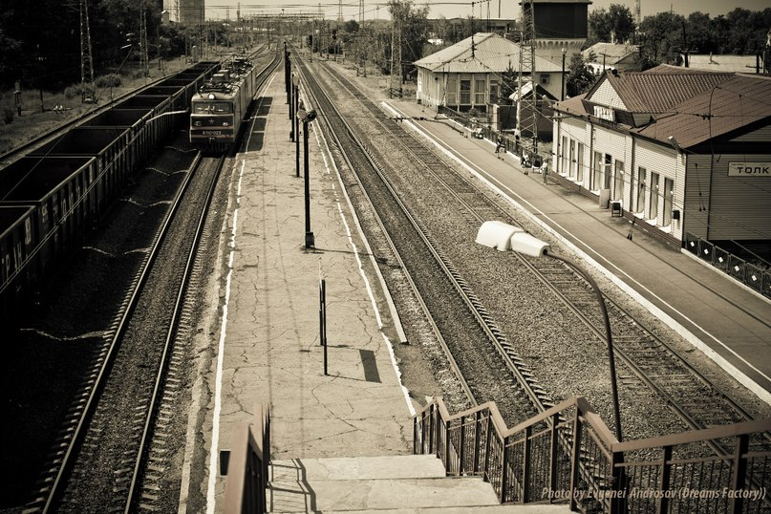
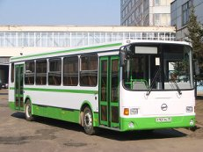
Transportation
In the southern part of the village is a railway station on the highway Drop "Samara-Ufa", through which several pairs of trains per day and more than a dozen stops distance trains. Near the train station, the bus station, serving more than a dozen coaches. Public transport in rural areas is provided by bus and taxi fleets.

Slide 6
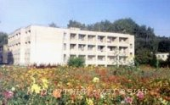
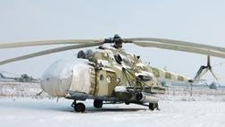
Infrastructure
On the eastern outskirts of the village located resort “Kolos", which annually going children from around the area. In the south-eastern outskirts of the village was part of a military helicopter, but it was disbanded in 2010.

Slide 7
Media
There is a local newspaper "Working Life", which was started in 1930. It focuses on the various events, activities in the village.

Slide 8
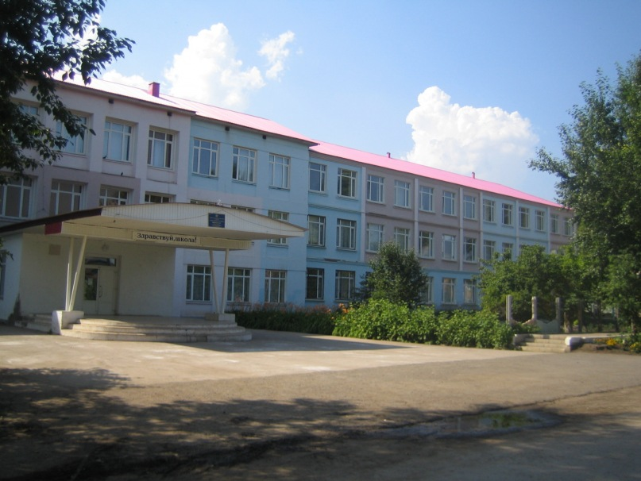
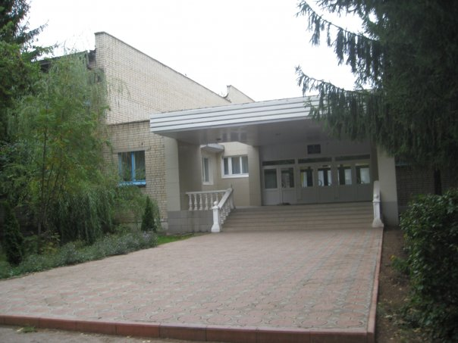
Education
The village has 3 full secondary education schools, College of Medicine, Agricultural College.

Slide 9
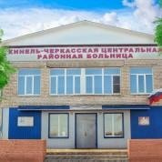
Medicine
The village has polyclinic and hospital

Slide 10
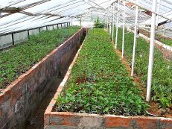
Attraction
The main attraction - this greenhouse. In every second yard in the village there are huge greenhouses are grown tomatoes, cucumbers and other vegetables, the sale of which is the basis of the well-being of the vast villagers.

Slide 11
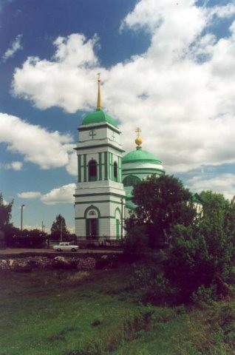
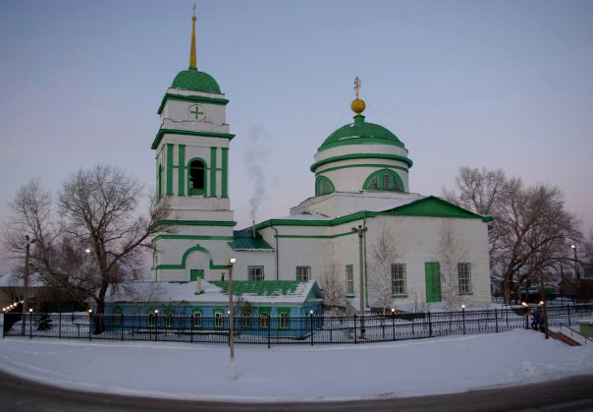
In the village we have Ascension Church, built in Romanesque style in 1839 (but service never been stopped). In Stalin's time was one of the three active churches in the area.

Slide 12
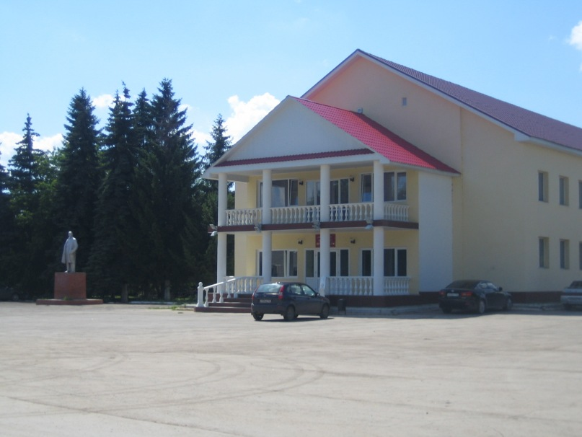
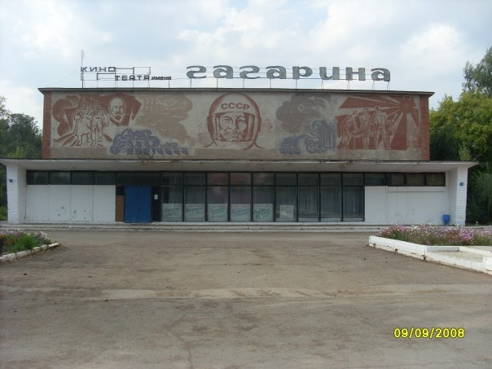
In the center of the village there is a museum, a cultural center with national theater, Gagarin's cinema. Another attraction of the village is the home of youth organizations. When DHS has various youth organizations. In July, near the village festival of bard them Tarabrina.

Slide 13
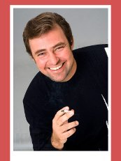
Notable natives
Kuchta, Oleg V. - actor and singer, Honoured Artist of Russia.

Slide 14
Thank you for your attention

