Slide 1
Music in our life
Created by Vsevolod Mashanov
2017

Slide 2
Main kinds of music
Rock
Rap
Club Music
Classical Music
Metal
Pop-music
Electro-music

Slide 3
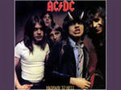
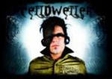
The music my friends are listening to
Most of my friends listen to rock:
Skillet
AC/DC
Nirvana
Billy Talent
Oomph
And electro-music:
Blue Stahli
The Prodigy
Celldweller
Pendulum

Slide 4
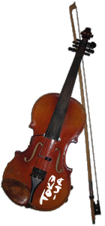
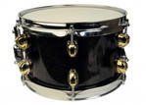
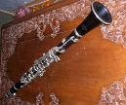
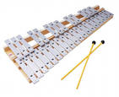
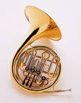
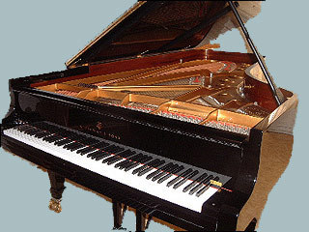
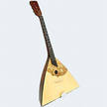
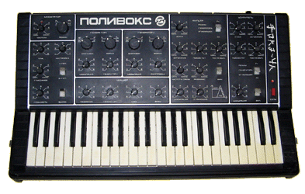
Musical Instruments

Slide 5
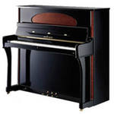
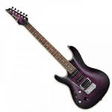
The musical instruments my friends play
One of my friends play the electro-guitar
Two of my friends and my sister play the piano

Slide 6
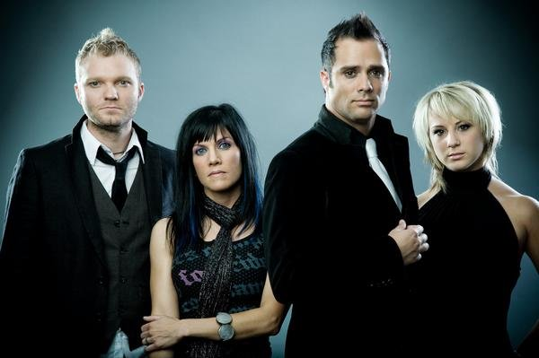
Skillet is my favourite group
Skillet is tagged as: christian rock, rock, alternative rock. In their music the elements of old school progressive rock are mixed with modern alternative elements of classical rock. The hit albums are: Skillet, Hey You I Love Your Soul,
Invincible Ardent Worship, Alien Youth, Collide, Comatose, Awake.

Slide 7
Thanks for watching!

