Slide 1
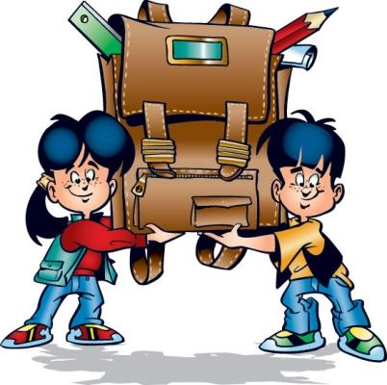
My School Traditions
Performed:
Gajiyeva
8 ”G” student
2017 year

Slide 2
Content
General information
Main traditions
Self-management
Territory cleaning
Teachers' Day
Day of health
Conclusion

Slide 3
General information
Traditions of school keep the eternal valuable: continuity of generations, love and respect for history of native school, aspiration to increase its glory...
Academic year at our school begins with September 1. And comes to an end in May.
At school there is a self-government. Wishing to become the president, represent the program and on the basis of elections. Choose the president.

Slide 4
Main traditions
Knowledge Day
Teachers' Day
Dedication in first graders
Day of self-government
Holiday of a New Year tree
The holiday devoted to Day of the defender of the Fatherland
Evening of a meeting with graduates
"Mothers different are important..." - a holiday devoted to March 8
Shrovetide
Victory Day
Rewarding of winners of the Olympic Games and competitions
Last call
Graduation party of seniors

Slide 5
Self-management
Activity of school is carried out according to:
- School constitutions
- To the code of honor of school.
The school has the coat of arms, the anthem, a flag. Each house has the attributes. Activity of school will be organized by constant self-government institutions which can change depending on requirements of school. Work of school goes the centers (services) for age steps, the management of the centers is carried out by head and the adult adviser. The main representative of the power in school is the President who works together with the team.

Slide 6
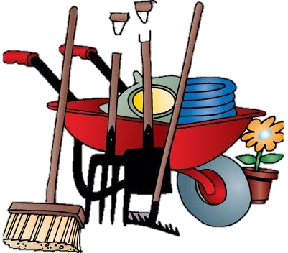
Territory cleaning
At our school conduct a community work day. Both in the school territory, and beyond its limits.
Them lead at the end of autumn and in the middle of the spring.

Slide 7
Teachers' Day
At our school at the beginning of a year conduct the world Teachers' Day. This day also spend day of self-government. Pupils of the senior classes conduct lessons. Everyone can test as the teacher.

Slide 8
Day of health
To thicket this day, competitions between classes in various sports are held. For example: basketball, volleyball, football.

Slide 9
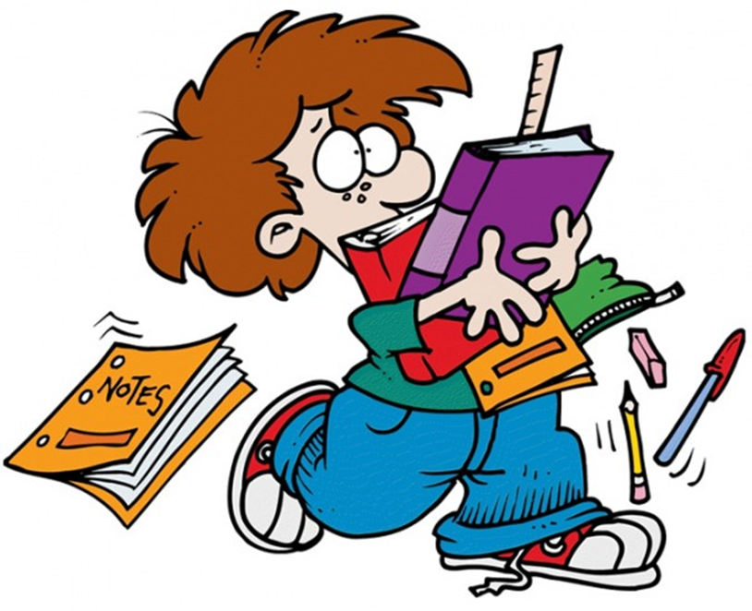
Conclusion
Traditions remain generations change, but them execute and support. Pupils of school think out scenarios, competitions. Have holidays, bring together on all of them pupils.

Slide 10
Thanks for attention!

