Slide 1
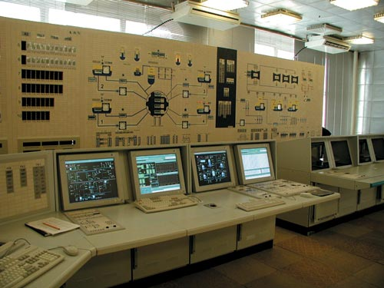
My future profession
Automatic control systems

Slide 2
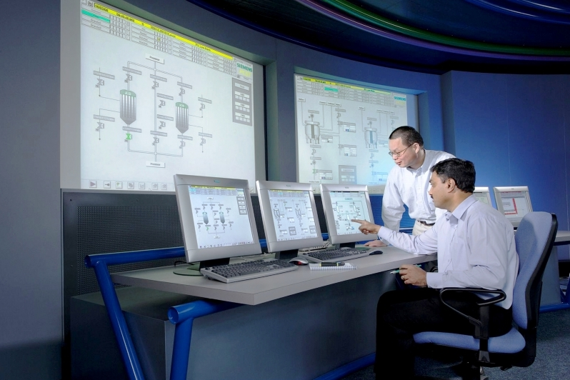
The role of ACS
ACS can:
Provide data for person which makes decisions
Speed-up some processes
Make some decisions itself
Improve control processes

Slide 3
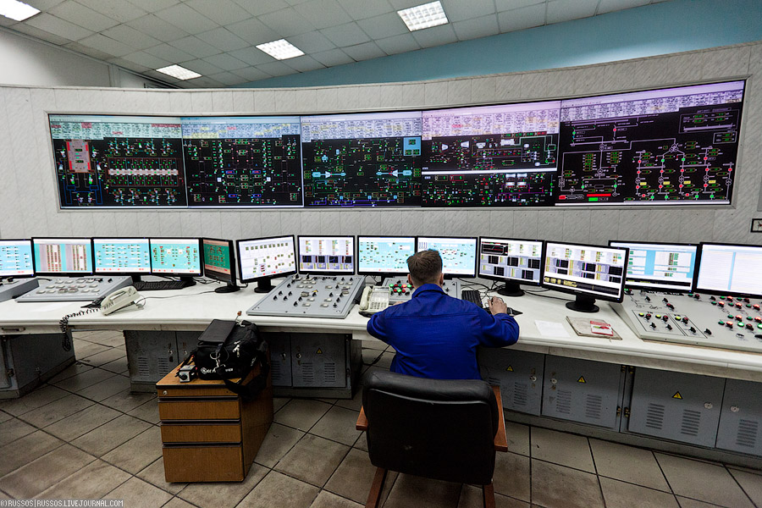
Usage of ACS
ACS is used for:
Control of industrial process
Control of factory
Control of street lighting
Control of traffic lights

Slide 4
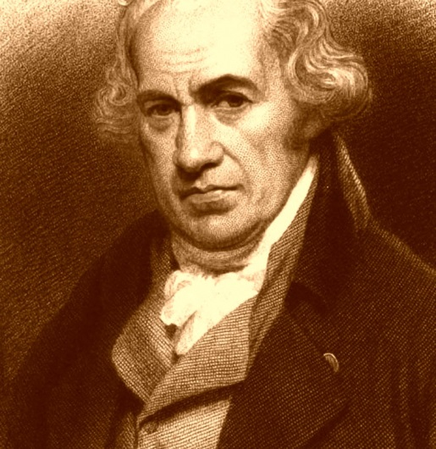
History of ACS
Ancient Greeks were the first who tried to create a mechanism which could stabilize itself or do some kinds of work without human.
The first one who created such thing was British scientist James Watt. He created a mechanism which can keep speed of locomotive the same for long time. Nowadays ACS is mostly effective as automation of factories.

Slide 5
Enterprises with ACS
A sample of automated enterprise in Belgorod is
boiler house QUADRA. Special devices measure temperature and pressure, system processes this data and makes decision: increase or decrease temperature\pressure.
measuring device
decision
element
control device

Slide 6
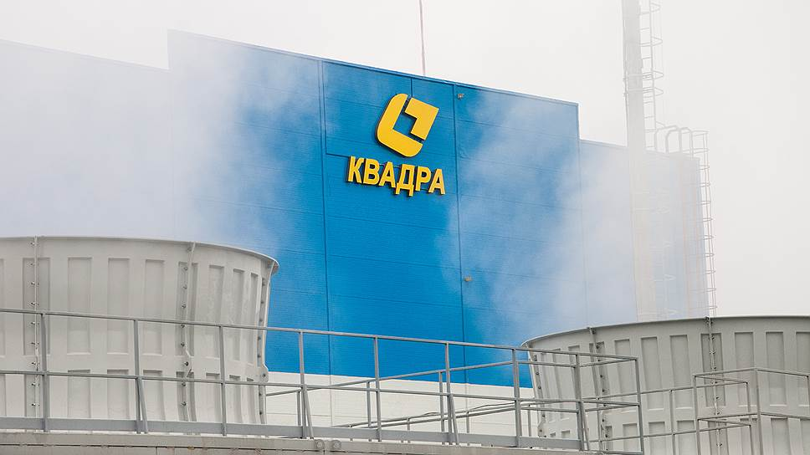
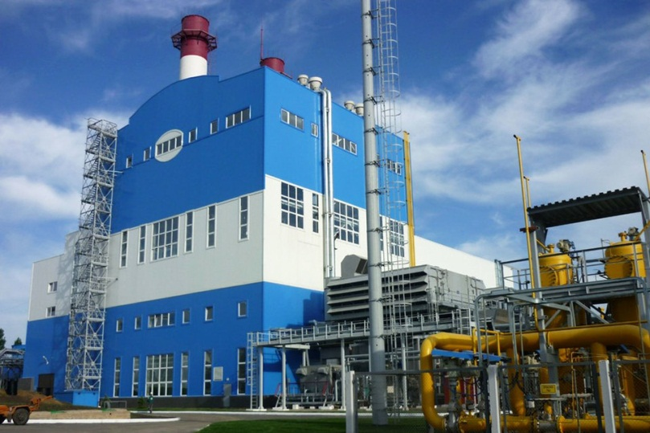
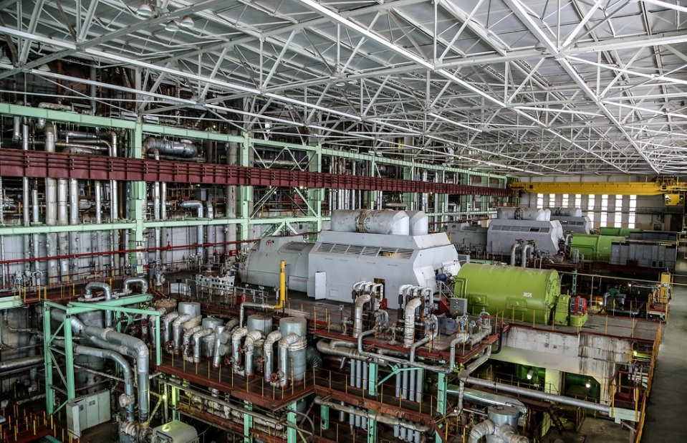
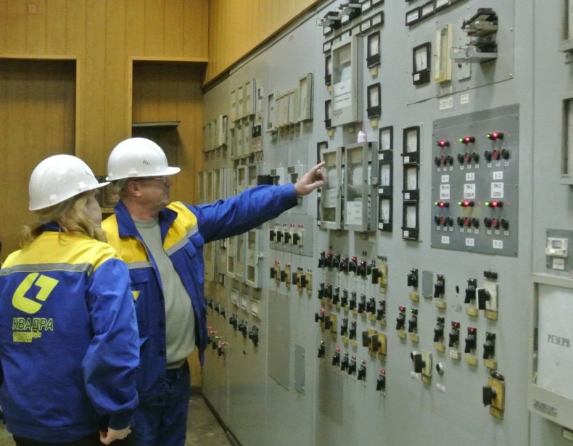
QUADRA

Slide 7
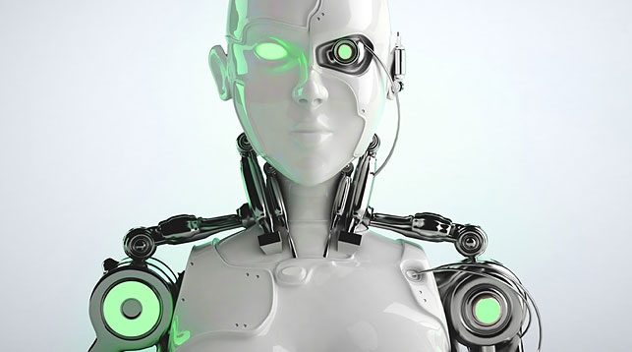
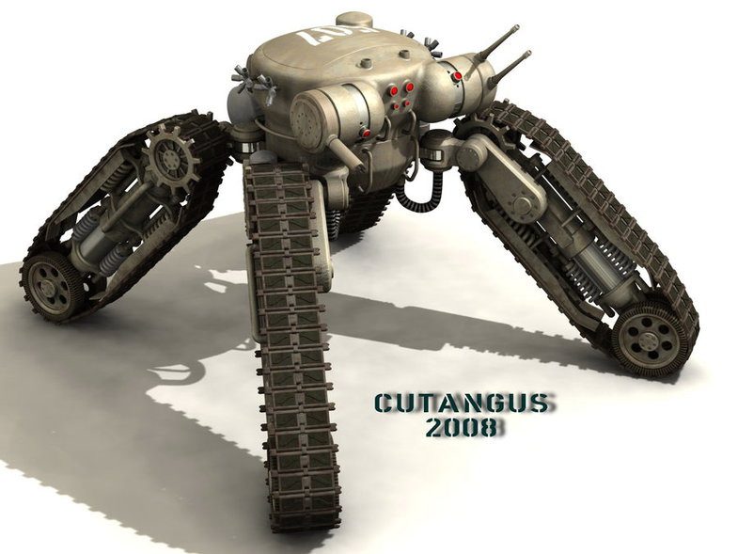
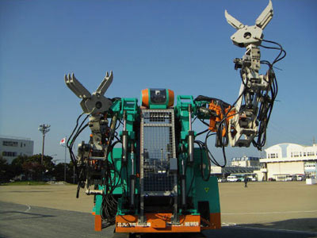
ACS in future
The next step in ACS’s evolution is creation of androids.
They can do some kinds of work better than human, faster, more precisely. Almost all work can be done by robots and if we’ll let machines do it for us, we’ll be freed from daily routine on work and dedicate ourselves to something else. But nobody knows will we create or destroy, will that future be full of light or full of war.

Slide 8
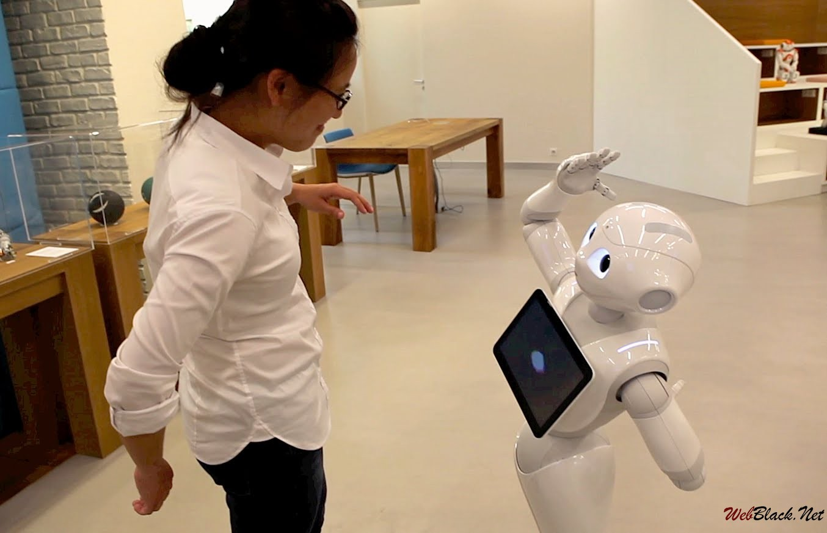
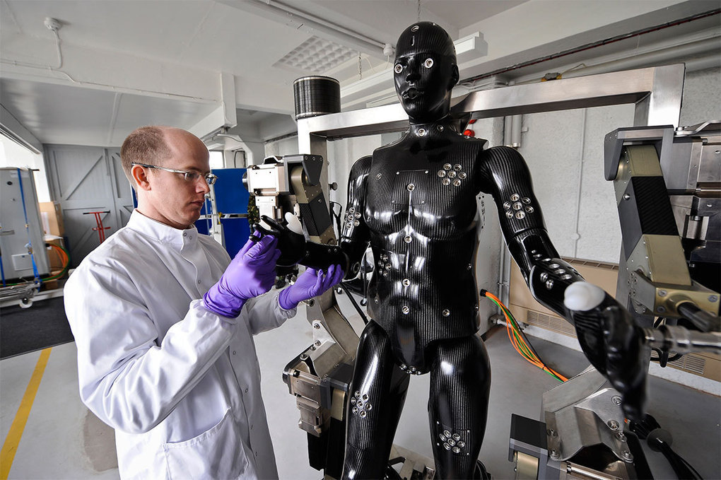
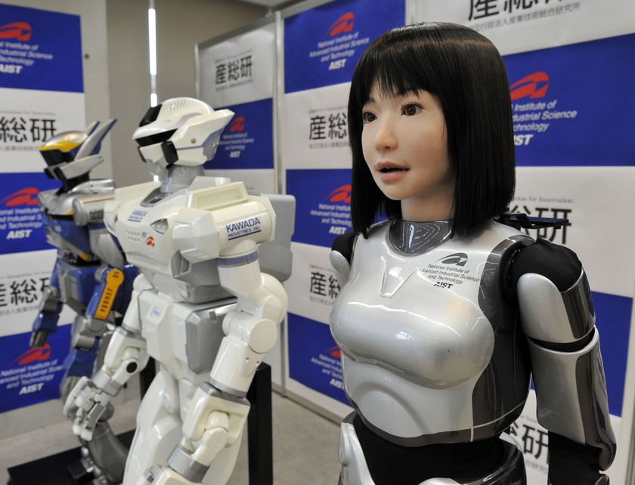
Androids

Slide 9
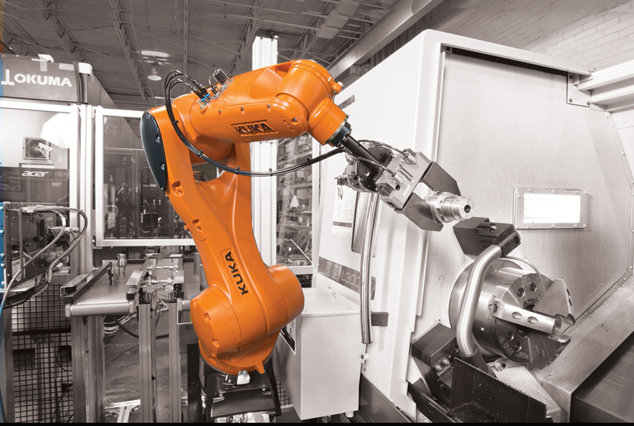
Thank you for attention!
Presentation was made by
Kliment Chervanyov
32 ACS

