Slide 1
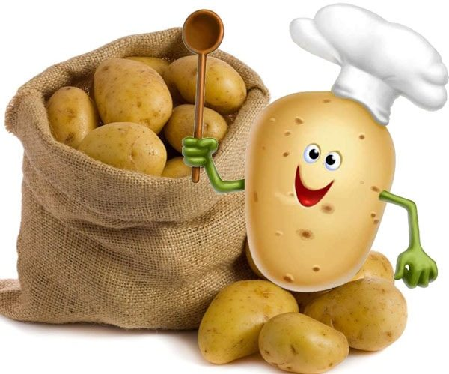
potato
1
2
3
4
5
6
7
more

Slide 2
4
3
1
5
2

Slide 3
7
9
6
8
10

Slide 4
4
7
3
1
8
6
9
5
10
2

Slide 6
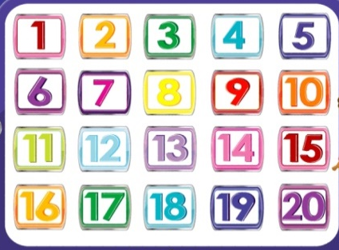
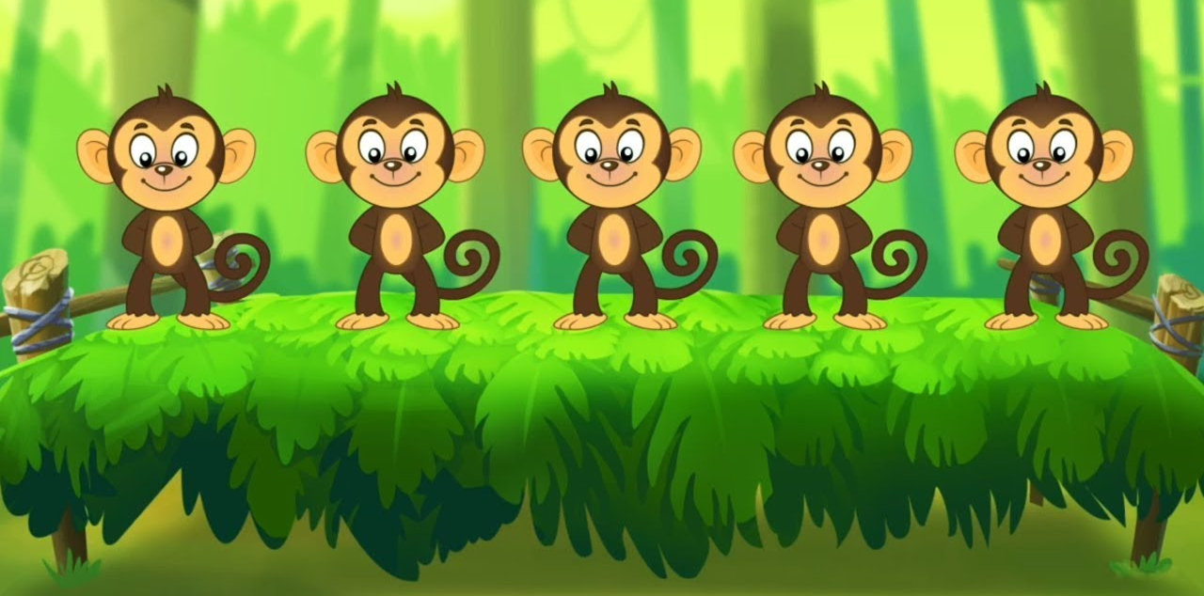
monkeys

Slide 7
4
7
3
1
8
11
12
6
9
5
10
2

Slide 8
One, two, buckle my shoe

Slide 9
Three, four, open the door

Slide 10
Five, six, pick up sticks

Slide 11
Five, six, pick up sticks
Three, four, open the door
One, two, buckle my shoe

Slide 12
Seven, eight, lay them straight

Slide 13
Nine, ten, a big fat hen.

Slide 14
Eleven, twelve, dig and delve.

Slide 15
Eleven, twelve, dig and delve.
Nine, ten, a big fat hen.
Seven, eight, lay them straight
Five, six, pick up sticks
Three, four, open the door
One, two, buckle my shoe

Slide 17
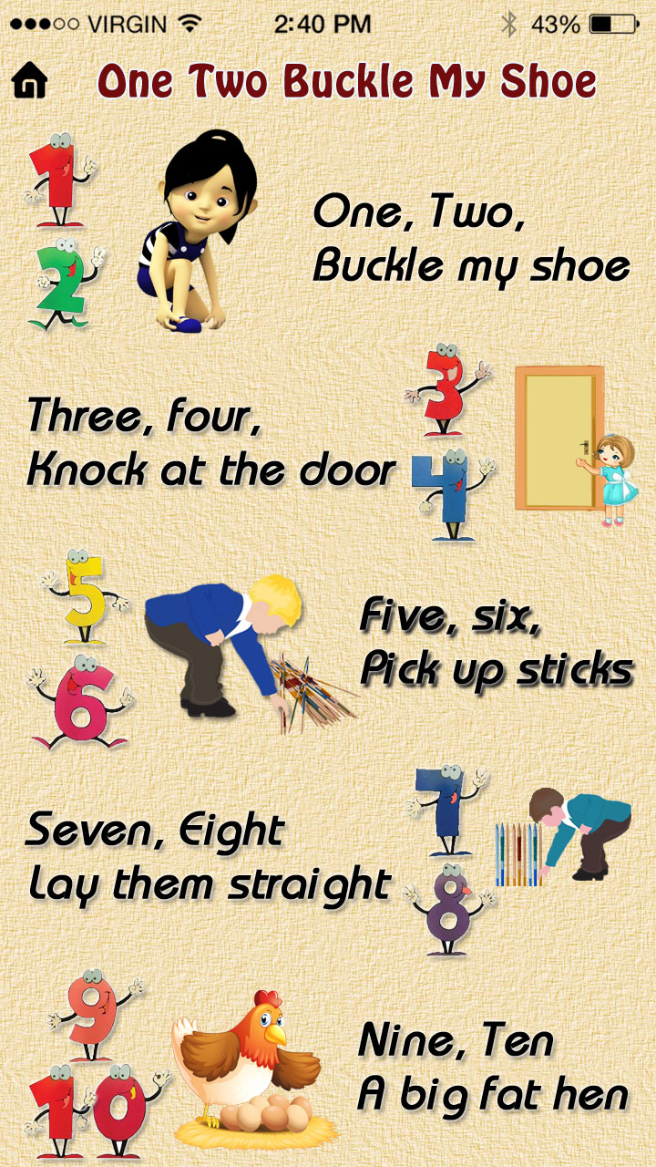
Open

Slide 18
monkeys

Slide 19
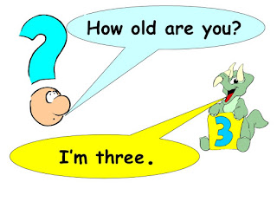
How Old Are You?
I am …
p.55

Slide 20
Reflexion
Super!
So-so…
Not good

