Slide 1

-"

Slide 2


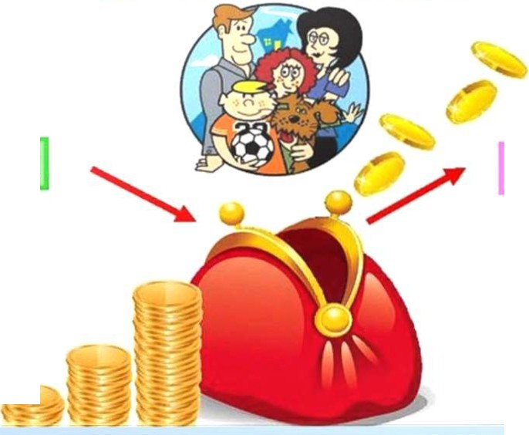


CeM eii1-l bti1 610d:JfCem
'Do;r_oobt.
Pac;w dbi
...., ⁻
$

Slide 3
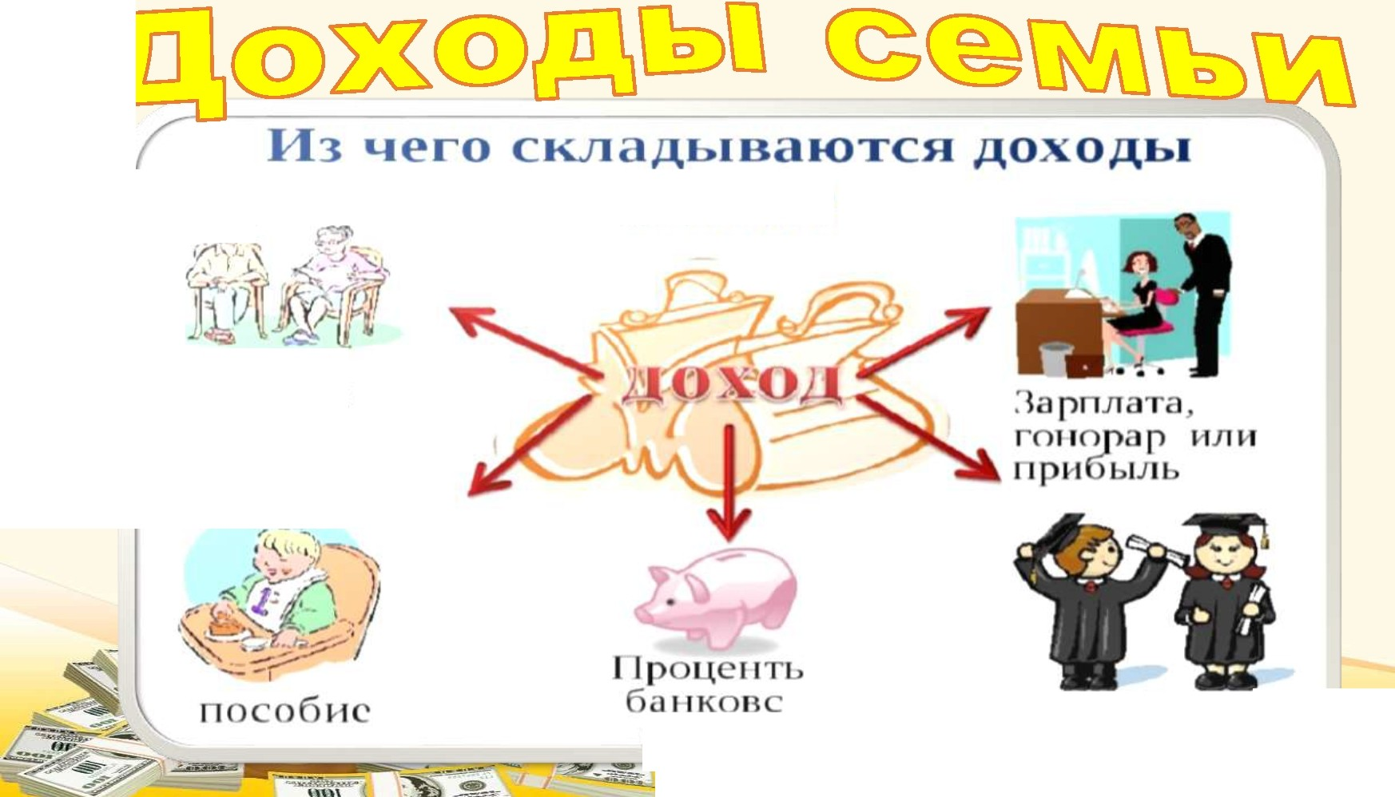

ce.Mbu?
C-.•
;r • ""'
I I eHC.MH
r o
I< I .f,, -
1311(J>K "1 11..1 vi

Slide 4
Onnara ll b
Tosapbl
ycnyr
0TAblX

Slide 5
Подарок
Выигрыш
Премия

Slide 6

(15
'IJ\SmnDOOCEOO
D

Slide 7
Ha l.fSvi MO>K-0 GKOrDMVllb?
TpaHcnopT
npoe3AHO 6111/leT, neWKOM
KsapTnnaTa
6epe4b cseT 111 BOAY
npoAYKTbl
MeHbwe noi<ynaTb Cfl8AOCT111
npOAYKTbl C np111 yceiAe 6HOfO y4aCTKc

Slide 8


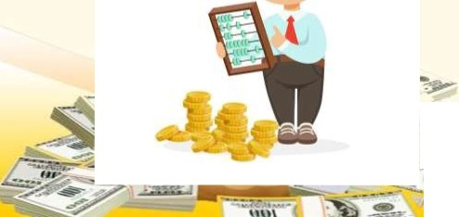

llro&w npa•-1tHo ll8CTll ce11ellHoe X0811llCl90,..,.eH nnaH iAOX°"°9 •
pacx....XO'lll tlw n •tln•
•HW .
._. .
A .,..•ecn. ce11allHwa
..:
"' ­_{r}
.
(J (J
(J (J
·-
.
,< -

