Slide 2
7 wonders of the world

Slide 3


Slide 4



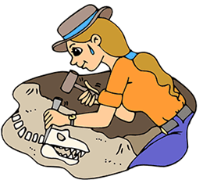




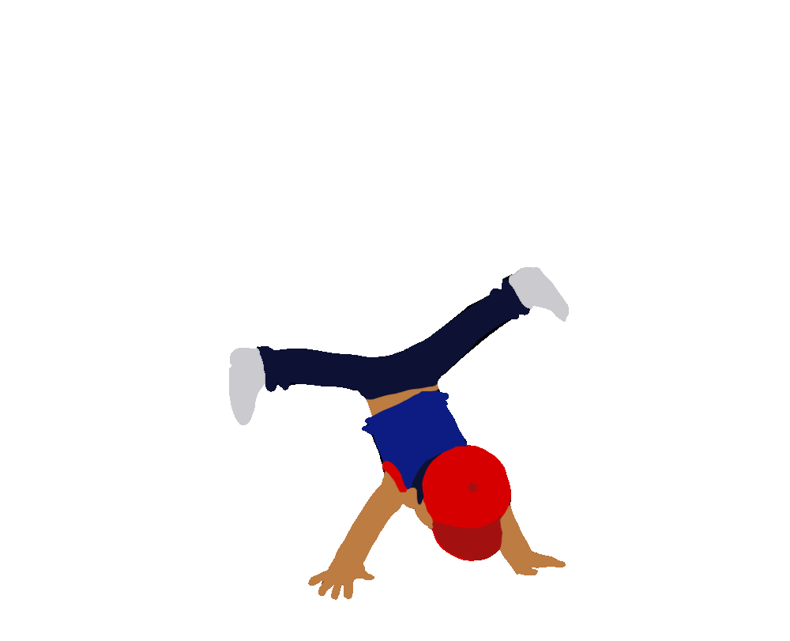
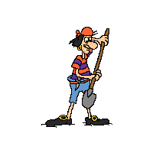
take photos
explore ancient things
play computer games
make notes
go to the cinema
do projects
sing songs
dig
dance

Slide 5


Slide 6
scrolls

Slide 7
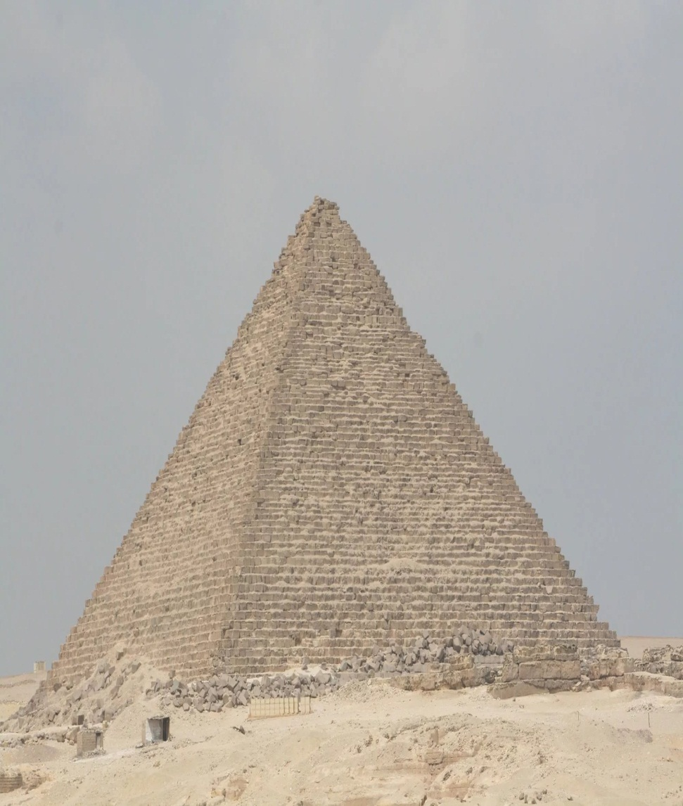
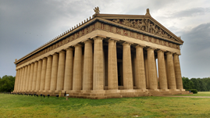
The Pyramid
The Parthenon

Slide 8
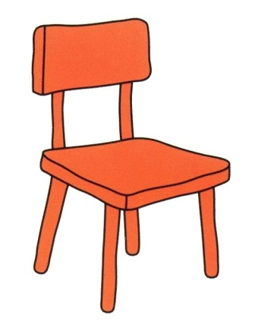


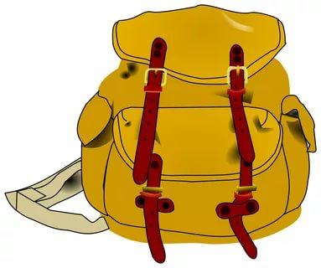
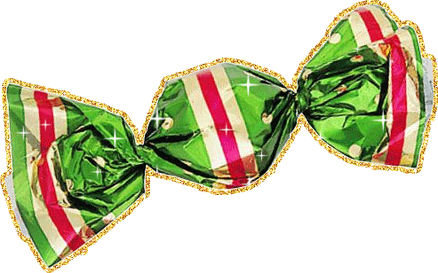

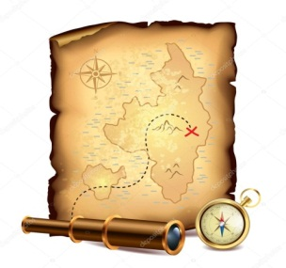

chair
loupe
compass
sweet
notebook
map
pen

Slide 9



Slide 10

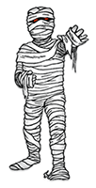



Slide 11

Before you go to explore the wonders, learn new words
Ready?

Slide 12


English - Russian
Egyptians
Египтяне
die
умирать
bury
хоронить
tomb
склеп
Greece
Греция
Greek
грек
temple
храм
Egypt
Египет
replay

Slide 13
Russian - English
Египет
Egypt
храм
temple
грек
Greek
Греция
Greece
склеп
tomb
хоронить
bury
умирать
die
Египтяне
Egyptians
replay

Slide 14

temple
church
tomb
palace

Slide 15
Egypt
Greece
Russia
England

Slide 16
Egyptian
Welsh
Greek
Poland

Slide 17
church
castle
tomb
temple

Slide 18
Greeks
Russian
Egyptians
Chinese

Slide 19
die
find
bury
dig

Slide 20


Well done. Before you discover the wonders, dance with me.

Slide 22

Now you may go!

Slide 23
You’ve got a stick in your bag.
Take it.
And scratch!

Slide 24
You’ve done it.
Good bye!

Slide 25

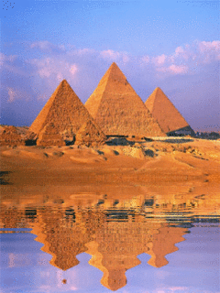

Where are they?
Egypt
Greece

Slide 26
How old are they?
4678
2. 2465

Slide 27
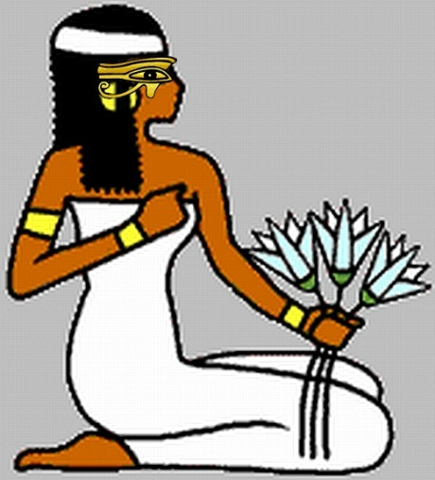
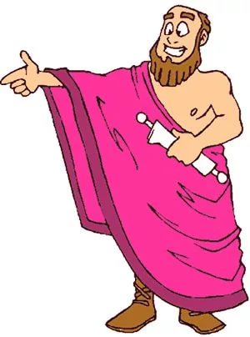
Who made them?
Egyptians
2. Greeks

Slide 28
What were they for?
Tomb
Temple

Slide 29


to the science conference!

Slide 30
Homework
Student book: p.91, the text about the Stonehenge
Create mini projects about it.

Slide 31


I liked the lesson.
I didn’t like the lesson.
The lesson was…
interesting useful boring

